Slide 1
Welcome!
Sunday
Bible Study 9:30 AM
Worship 10:30 AM
PM Bible Class (Livestream) 5:00 PM
Wednesday
Bible Class 7:00 PM
www.SunsetchurchofChrist.net

Slide 2
John 8:12
"I AM the light of the world”
I AM the Bread of Life - John 6:35
I AM the Door - John 10:7
I AM the Good Shepherd - John 10:11
I AM the Resurrection and the Life - John 11:25
I AM the Way, the Truth, and the Life - John 14:6
I AM the Vine - John 15:1

Slide 3
John 8:12-20
Testimony of Jesus
He was the Light of the World
Following Him removes darkness
He did not come to judge
John 5:22-27 (?)
John 3:17-19

Slide 4
John 8:21-30
Jesus reveals His goal
Belief in Jesus
Speaking from the Father

Slide 5
Welcome!
Sunday
Bible Study 9:30 AM
Worship 10:30 AM
PM Bible Class (Livestream) 5:00 PM
Wednesday
Bible Class 7:00 PM
www.SunsetchurchofChrist.net

Slide 6
Opening Prayer | Terry Petsche
Song – | Grant Haines
Scripture Reading | Lamar McDonald
Song – | Grant Haines
Song – | Grant Haines
Lord’s Supper | Lamar McDonald/Michael Hetzer
Song – | Grant Haines
Collection | Lamar McDonald/Michael Hetzer
Song – | Grant Haines
Lesson | Brian Haines
Song – | Grant Haines
Closing | Ryan Sollars

Slide 7
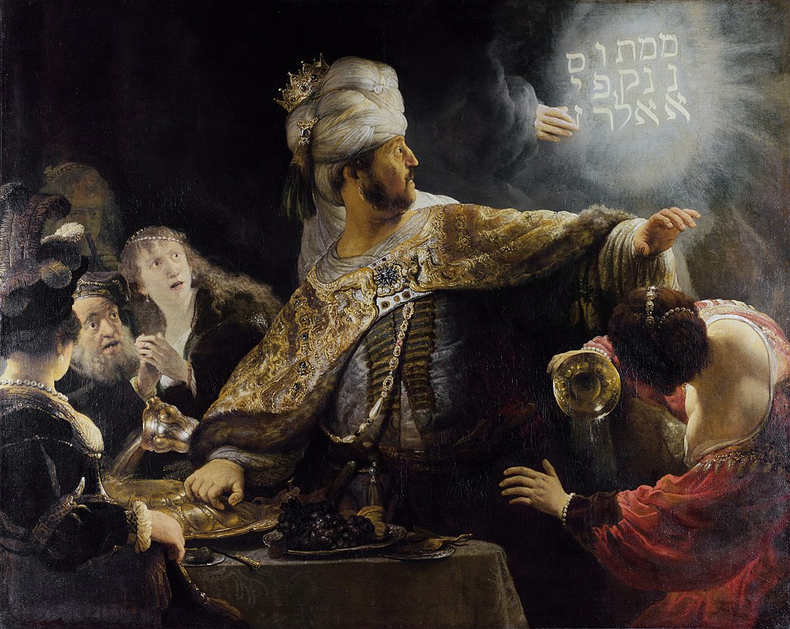
Daniel 5
Mene Mene Tekel Upharsin

Slide 8
Chiastic Nature of Daniel
- A
- B
- C
- C
- B
- A

Slide 9
Chiastic Nature of Daniel
- The Fifth Kingdom prophecy (2)
- 3 men in the fiery furnace (3)
- Interpreting a dream (4)
- Interpreting a vision (5)
- Daniel in the lion’s den (6)
- The Fifth Kingdom prophecy (7)

Slide 10
Chiastic Nature of Daniel
- The Fifth Kingdom prophecy (2)
- 3 men in the fiery furnace (3)
- Interpreting a dream (4)
- Interpreting a vision (5)
- Daniel in the lion’s den (6)
- The Fifth Kingdom prophecy (7)

Slide 11
Judgment on Belshazzar
1) A divine message
To a drunken despot
To a blasphemous king

Slide 12
Judgment on Belshazzar
1) A divine message
2) The call for diviners
Three times in Daniel they fail
The queen (mother) advises

Slide 13
Judgment on Belshazzar
1) A divine message
2) The call for diviners
3) Daniel interprets
Ignoring the life of Nebuchadnezzar

Slide 14
Judgment on Belshazzar
1) A divine message
2) The call for diviners
3) Daniel interprets
4) Conclusions
Daniel is promoted
The kingdom is lost

Slide 15
Lessons From Belshazzar
The BIG lesson:
We are ALL accountable to God
Romans 2:1-11
Matthew 16:27
2 Corinthians 5:10
Revelation 2:23
Notes:
Mt 16:27 "For the Son of Man will come in the glory of His Father with His angels, and then He will reward each according to his works.
2Co 5:10 For we must all appear before the judgment seat of Christ, that each one may receive the things done in the body, according to what he has done, whether good or bad.
Re 2:23 "I will kill her children with death, and all the churches shall know that I am He who searches the minds and hearts. And I will give to each one of you according to your works.

Slide 16
Lessons From Belshazzar
The BIG lesson:
We are ALL accountable to God
Accountable for what we CAN know

Slide 17
Lessons From Belshazzar
The other lesson
What are the Holy Vessels?
1 Thessalonians 4:4
2 Corinthians 4:7
Notes:
1Th 4:4 that each of you know how to possess his own vessel in sanctification and honor,
2Co 4:7 But we have this treasure in earthen vessels, that the excellence of the power may be of God and not of us.

Slide 18
Lessons From Belshazzar
The other lesson
What are the Holy Vessels?
Using Holy Vessels for unholy things?
2 Corinthians 6:14-17
1 Corinthians 6:19-20
Notes:
2Co 6:14 Do not be unequally yoked together with unbelievers. For what fellowship has righteousness with lawlessness? And what communion has light with darkness? 15 And what accord has Christ with Belial? Or what part has a believer with an unbeliever? 16 And what agreement has the temple of God with idols? For you are the temple of the living God. As God has said: "I will dwell in them And walk among them. I will be their God, And they shall be My people." 17 Therefore "Come out from among them And be separate, says the Lord. Do not touch what is unclean, And I will receive you." 18 "I will be a Father to you, And you shall be My sons and daughters, Says the LORD Almighty.“
1Co 6:19 Or do you not know that your body is the temple of the Holy Spirit who is in you, whom you have from God, and you are not your own? 20 For you were bought at a price; therefore glorify God in your body and in your spirit, which are God's.

Slide 19
Lessons From Belshazzar
Be prepared to stand before God
Each one of us shall give account of himself to God
Romans 14:12
Notes:
Ro 14:12 So then each one of us shall give account of himself to God.
2Ti 2:19 ¶ Nevertheless the solid foundation of God stands, having this seal: "The Lord knows those who are His," and, "Let everyone who names the name of Christ depart from iniquity." 20 But in a great house there are not only vessels of gold and silver, but also of wood and clay, some for honor and some for dishonor. 21 Therefore if anyone cleanses himself from the latter, he will be a vessel for honor, sanctified and useful for the Master, prepared for every good work.

Slide 20
Lessons From Belshazzar
Be prepared to stand before God
Romans 14:12
Cleanse yourself for service
2 Timothy 2:19-21
Notes:
Ro 14:12 So then each one of us shall give account of himself to God.
2Ti 2:19 ¶ Nevertheless the solid foundation of God stands, having this seal: "The Lord knows those who are His," and, "Let everyone who names the name of Christ depart from iniquity." 20 But in a great house there are not only vessels of gold and silver, but also of wood and clay, some for honor and some for dishonor. 21 Therefore if anyone cleanses himself from the latter, he will be a vessel for honor, sanctified and useful for the Master, prepared for every good work.

Slide 21
Now all these things happened to them as examples, and they were written for our admonition, upon whom the ends of the ages have come. 1 Corinthians 10:11
Notes:
Mt 28:20 teaching them to observe all that I commanded you; and lo, I am with you always, even to the end of the age.“
2Ti 4:18 The Lord will deliver me from every evil deed, and will bring me safely to His heavenly kingdom; to Him [be] the glory forever and ever. Amen.

Slide 23
What If It Were On Your Wall
YOU have sinned and
fall short of the glory of God
Romans 3:23
Notes:
Ac 15:11 "But we believe that we are saved through the grace of the Lord Jesus, in the same way as they also are."

Slide 24
What If It Were On Your Wall
YOU have sinned and
fall short of the glory of God
AND the wages of sin is death
Romans 3:23, 6:23

Slide 25
The Writing on the Wall
Pleading Christ as our defense:
By hearing and believing – Romans 10:17
By confession of Jesus – Matthew 10:32
By repenting of sin – Acts 2:38
By being baptized into Christ – Acts 20:16

